Slide 2
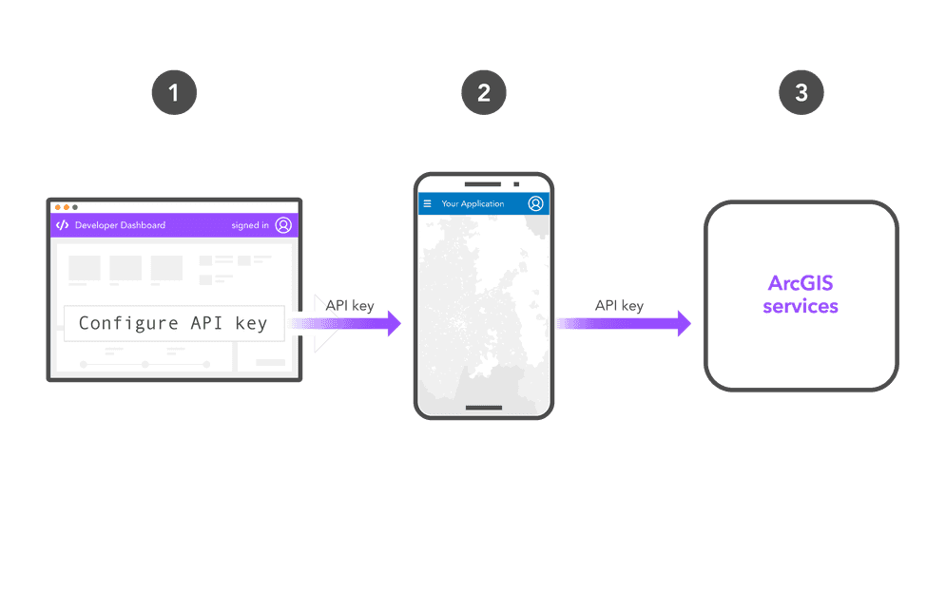
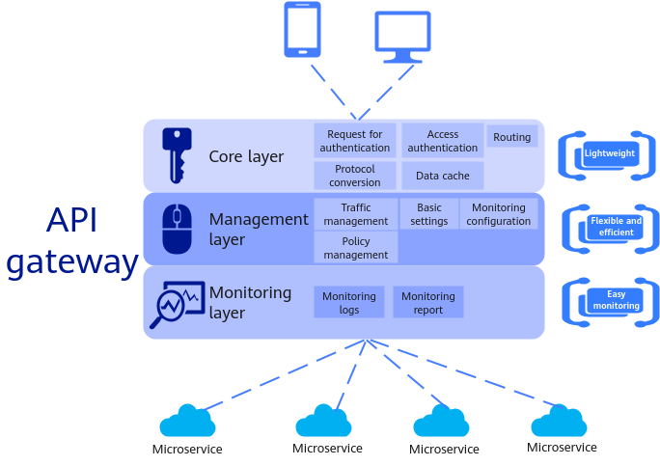

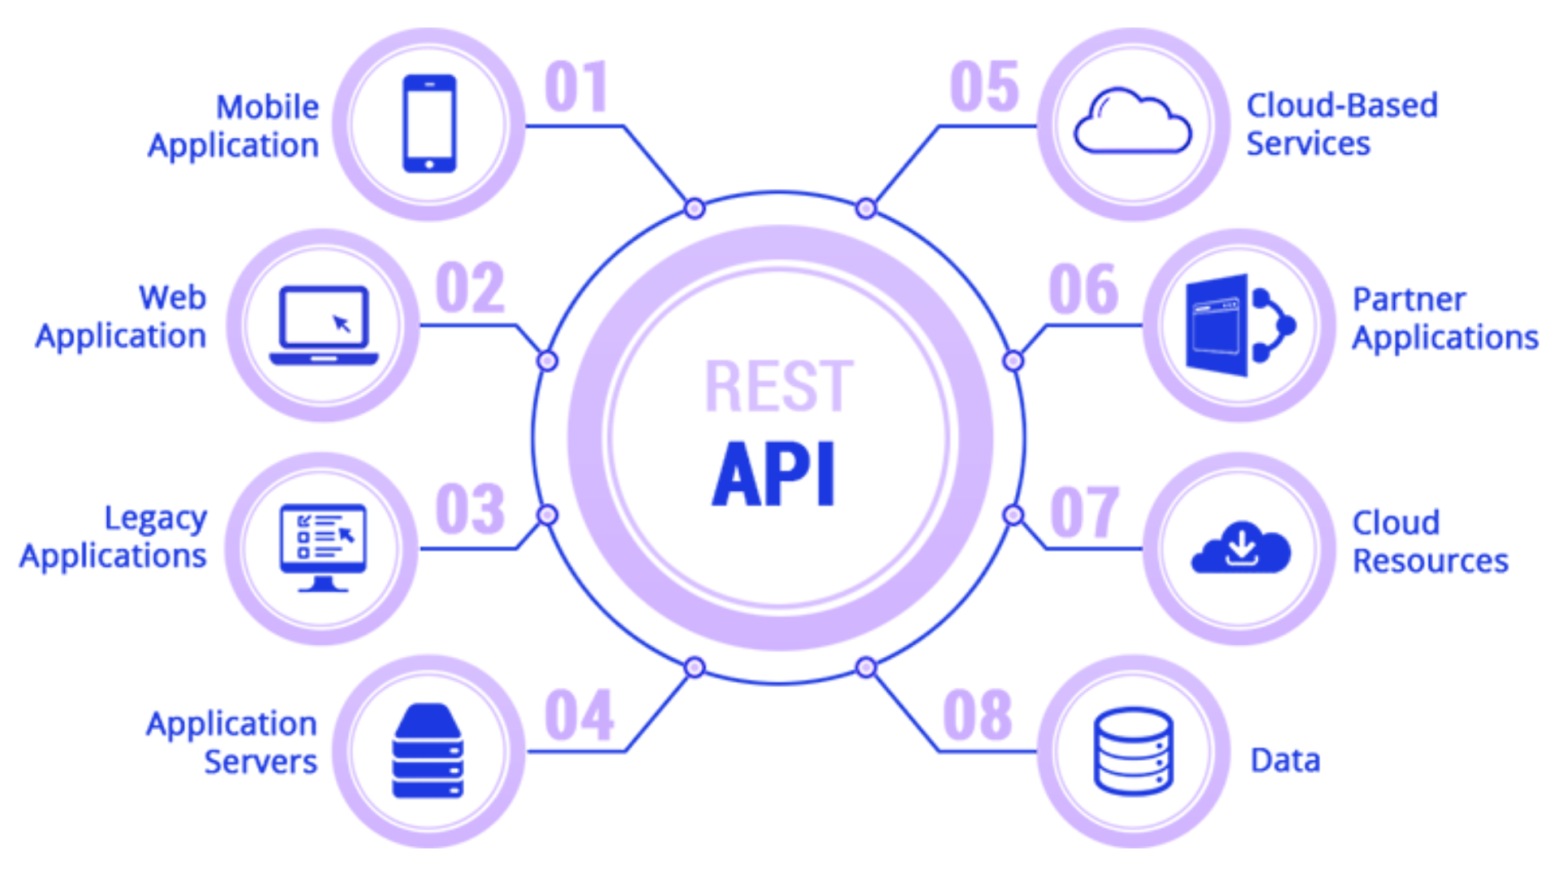
01
03
04
02
1
A.P.I
Lorem inesldfncjkws dkjc
Lorem inesldfncjkws dkjc
Lorem inesldfncjkws dkjc
Suebvkdnkjvner ksjdnzvk nwrsdlknxzcvkl wmdslkxzmv klwmdsklxzvm klwedsnxzklcvne dklsxnvkl ewndsklxzvn jklewsdnxzjklv nwdjksxznv jkw dsjkxzvn jkrwdsnxzjkvl nwkldsxzncvkl wnedsklxzv nwdskxznv klds
Suebvkdnkjvner ksjdnzvk nwrsdlknxzcvkl wmdslkxzmv klwmdsklxzvm klwedsnxzklcvne dklsxnvkl ewndsklxzvn jklewsdnxzjklv nwdjksxznv jkw dsjkxzvn jkrwdsnxzjkvl nwkldsxzncvkl wnedsklxzv nwdskxznv klds
2
Suebvkdnkjvner ksjdnzvk nwrsdlknxzcvkl wmdslkxzmv klwmdsklxzvm klwedsnxzklcvne dklsxnvkl ewndsklxzvn jklewsdnxzjklv nwdjksxznv jkw dsjkxzvn jkrwdsnxzjkvl nwkldsxzncvkl wnedsklxzv nwdskxznv klds
Suebvkdnkjvner ksjdnzvk nwrsdlknxzcvkl wmdslkxzmv klwmdsklxzvm klwedsnxzklcvne dklsxnvkl ewndsklxzvn jklewsdnxzjklv nwdjksxznv jkw dsjkxzvn jkrwdsnxzjkvl nwkldsxzncvkl wnedsklxzv nwdskxznv klds
Application Programming Interface
3
4
By Melvin Berkoh

Slide 3
04
01
03
02
1
Understanding APIs: An Introduction
Lorem inesldfncjkws dkjc
A.P.I
Lorem inesldfncjkws dkjc
Suebvkdnkjvner ksjdnzvk nwrsdlknxzcvkl wmdslkxzmv klwmdsklxzvm klwedsnxzklcvne dklsxnvkl ewndsklxzvn jklewsdnxzjklv nwdjksxznv jkw dsjkxzvn jkrwdsnxzjkvl nwkldsxzncvkl wnedsklxzv nwdskxznv klds
Suebvkdnkjvner ksjdnzvk nwrsdlknxzcvkl wmdslkxzmv klwmdsklxzvm klwedsnxzklcvne dklsxnvkl ewndsklxzvn jklewsdnxzjklv nwdjksxznv jkw dsjkxzvn jkrwdsnxzjkvl nwkldsxzncvkl wnedsklxzv nwdskxznv klds
2
Its connectivity interfaces to an application
A software intermediary that allows two applications to talk to each other.
Classified into two types:
Open API
Private API
Suebvkdnkjvner ksjdnzvk nwrsdlknxzcvkl wmdslkxzmv klwmdsklxzvm klwedsnxzklcvne dklsxnvkl ewndsklxzvn jklewsdnxzjklv nwdjksxznv jkw dsjkxzvn jkrwdsnxzjkvl nwkldsxzncvkl wnedsklxzv nwdskxznv klds
Application Programming Interface
3
4

Slide 4
03
01
04
02
1
How APIs Work
Lorem inesldfncjkws dkjc
Lorem inesldfncjkws dkjc
A.P.I
Come in the form of a library
This library provides a set of functions that can be called upon to perform various tasks
The API specifies the function calls, the inputs they accept, and the outputs they return.
Suebvkdnkjvner ksjdnzvk nwrsdlknxzcvkl wmdslkxzmv klwmdsklxzvm klwedsnxzklcvne dklsxnvkl ewndsklxzvn jklewsdnxzjklv nwdjksxznv jkw dsjkxzvn jkrwdsnxzjkvl nwkldsxzncvkl wnedsklxzv nwdskxznv klds
2
Suebvkdnkjvner ksjdnzvk nwrsdlknxzcvkl wmdslkxzmv klwmdsklxzvm klwedsnxzklcvne dklsxnvkl ewndsklxzvn jklewsdnxzjklv nwdjksxznv jkw dsjkxzvn jkrwdsnxzjkvl nwkldsxzncvkl wnedsklxzv nwdskxznv klds
Suebvkdnkjvner ksjdnzvk nwrsdlknxzcvkl wmdslkxzmv klwmdsklxzvm klwedsnxzklcvne dklsxnvkl ewndsklxzvn jklewsdnxzjklv nwdjksxznv jkw dsjkxzvn jkrwdsnxzjkvl nwkldsxzncvkl wnedsklxzv nwdskxznv klds
Application Programming Interface
3
4

Slide 5
02
03
01
04
1
Types of APIs
Lorem inesldfncjkws dkjc
A.P.I
Benefits and Application
Lorem inesldfncjkws dkjc
Open APIs: These are made available to developers outside the organization that created them.
Internal APIs: These are used within an organization to share resources and functionality between different teams or systems.
Partner APIs: These APIs are available to a specific group of developers who have a business relationship with the organization that created the API.
Composite APIs: combine multiple underlying APIs into a single interface.
Suebvkdnkjvner ksjdnzvk nwrsdlknxzcvkl wmdslkxzmv klwmdsklxzvm klwedsnxzklcvne dklsxnvkl ewndsklxzvn jklewsdnxzjklv nwdjksxznv jkw dsjkxzvn jkrwdsnxzjkvl nwkldsxzncvkl wnedsklxzv nwdskxznv klds
Suebvkdnkjvner ksjdnzvk nwrsdlknxzcvkl wmdslkxzmv klwmdsklxzvm klwedsnxzklcvne dklsxnvkl ewndsklxzvn jklewsdnxzjklv nwdjksxznv jkw dsjkxzvn jkrwdsnxzjkvl nwkldsxzncvkl wnedsklxzv nwdskxznv klds
Suebvkdnkjvner ksjdnzvk nwrsdlknxzcvkl wmdslkxzmv klwmdsklxzvm klwedsnxzklcvne dklsxnvkl ewndsklxzvn jklewsdnxzjklv nwdjksxznv jkw dsjkxzvn jkrwdsnxzjkvl nwkldsxzncvkl wnedsklxzv nwdskxznv klds
2
Application Programming Interface
3
4

Slide 6
01
02
03
04
Types of
1
Lorem inesldfncjkws dkjc
A.P.I
Benefits and Application
Lorem inesldfncjkws dkjc
Suebvkdnkjvner ksjdnzvk nwrsdlknxzcvkl wmdslkxzmv klwmdsklxzvm klwedsnxzklcvne dklsxnvkl ewndsklxzvn jklewsdnxzjklv nwdjksxznv jkw dsjkxzvn jkrwdsnxzjkvl nwkldsxzncvkl wnedsklxzv nwdskxznv klds
Suebvkdnkjvner ksjdnzvk nwrsdlknxzcvkl wmdslkxzmv klwmdsklxzvm klwedsnxzklcvne dklsxnvkl ewndsklxzvn jklewsdnxzjklv nwdjksxznv jkw dsjkxzvn jkrwdsnxzjkvl nwkldsxzncvkl wnedsklxzv nwdskxznv klds
APIs allow one computer program's capabilities to be utilized by another.
They allow two separate programs to communicate with one another.
Examples of API’s being used
Log-in Using XYZ
Pay with PayPal
Google Maps
2
Suebvkdnkjvner ksjdnzvk nwrsdlknxzcvkl wmdslkxzmv klwmdsklxzvm klwedsnxzklcvne dklsxnvkl ewndsklxzvn jklewsdnxzjklv nwdjksxznv jkw dsjkxzvn jkrwdsnxzjkvl nwkldsxzncvkl wnedsklxzv nwdskxznv klds
Application Programming Interface
3
4

Slide 7
Works Cited Page
01
03
04
02
1
Lorem inesldfncjkws dkjc
Lorem inesldfncjkws dkjc
Lorem inesldfncjkws dkjc
Suebvkdnkjvner ksjdnzvk nwrsdlknxzcvkl wmdslkxzmv klwmdsklxzvm klwedsnxzklcvne dklsxnvkl ewndsklxzvn jklewsdnxzjklv nwdjksxznv jkw dsjkxzvn jkrwdsnxzjkvl nwkldsxzncvkl wnedsklxzv nwdskxznv klds
Suebvkdnkjvner ksjdnzvk nwrsdlknxzcvkl wmdslkxzmv klwmdsklxzvm klwedsnxzklcvne dklsxnvkl ewndsklxzvn jklewsdnxzjklv nwdjksxznv jkw dsjkxzvn jkrwdsnxzjkvl nwkldsxzncvkl wnedsklxzv nwdskxznv klds
2
Any Questions?
Suebvkdnkjvner ksjdnzvk nwrsdlknxzcvkl wmdslkxzmv klwmdsklxzvm klwedsnxzklcvne dklsxnvkl ewndsklxzvn jklewsdnxzjklv nwdjksxznv jkw dsjkxzvn jkrwdsnxzjkvl nwkldsxzncvkl wnedsklxzv nwdskxznv klds
Suebvkdnkjvner ksjdnzvk nwrsdlknxzcvkl wmdslkxzmv klwmdsklxzvm klwedsnxzklcvne dklsxnvkl ewndsklxzvn jklewsdnxzjklv nwdjksxznv jkw dsjkxzvn jkrwdsnxzjkvl nwkldsxzncvkl wnedsklxzv nwdskxznv klds
3
Radhika. 7 API Examples We Use in Our Everyday Lives, Turing Enterprises Inc, 3 May 2022, www.turing.com/kb/7-examples-of-apis.
“What Is an API? (Application Programming Interface).” MuleSoft, www.mulesoft.com/resources/api/what-is-an-api. Accessed 18 Apr. 2024.
“What Is an API? How Apis Work, Simply Explained.” Contentful, Contentful, GmbH, www.contentful.com/api/#types-of-apis. Accessed 18 Apr. 2024.
4

Slide 8
04
Lorem inesldfncjkws dkjc
Suebvkdnkjvner ksjdnzvk nwrsdlknxzcvkl wmdslkxzmv klwmdsklxzvm klwedsnxzklcvne dklsxnvkl ewndsklxzvn jklewsdnxzjklv nwdjksxznv jkw dsjkxzvn jkrwdsnxzjkvl nwkldsxzncvkl wnedsklxzv nwdskxznv klds
4

Slide 9
03
Lorem inesldfncjkws dkjc
Suebvkdnkjvner ksjdnzvk nwrsdlknxzcvkl wmdslkxzmv klwmdsklxzvm klwedsnxzklcvne dklsxnvkl ewndsklxzvn jklewsdnxzjklv nwdjksxznv jkw dsjkxzvn jkrwdsnxzjkvl nwkldsxzncvkl wnedsklxzv nwdskxznv klds
3

Slide 10
02
Lorem inesldfncjkws dkjc
Suebvkdnkjvner ksjdnzvk nwrsdlknxzcvkl wmdslkxzmv klwmdsklxzvm klwedsnxzklcvne dklsxnvkl ewndsklxzvn jklewsdnxzjklv nwdjksxznv jkw dsjkxzvn jkrwdsnxzjkvl nwkldsxzncvkl wnedsklxzv nwdskxznv klds
2

Slide 11
01
1
Lorem inesldfncjkws dkjc
Suebvkdnkjvner ksjdnzvk nwrsdlknxzcvkl wmdslkxzmv klwmdsklxzvm klwedsnxzklcvne dklsxnvkl ewndsklxzvn jklewsdnxzjklv nwdjksxznv jkw dsjkxzvn jkrwdsnxzjkvl nwkldsxzncvkl wnedsklxzv nwdskxznv klds

